Slide 1

Interior On You(IOU)
Capstone Design
Team O8O
Project Proposal

Slide 2


Project Motivation
Project Goal & Details
Project Development – Language & Platform
Difference with other Program
Project Schedule
content

Slide 3


1. Project Motivation
Decorating
-How to ask?
-Where to ask?

Slide 4
1. Project Motivation
Decorating
-How to ask?
-Where to ask?
Interior On You(IOU)

Slide 5



2. Project Goal & Details
Improve User’s Interior
Based On User’s Preference

Slide 6



2. Project Goal & Details
Auto-recommendation system
Pre-placing system
360˚

Slide 7

2. Project Goal & Details
Notice Board
Recommendation
Vote
Information

Slide 8



2. Project Goal & Details
Preference

Slide 9




3. Project Development – Language & Platform

Slide 10



3. Project Development – Language & Platform

Slide 11


3. Project Development – Language & Platform

Slide 12




4. Difference with other Program
Other
Program
Capstone
Hotplace

Slide 13
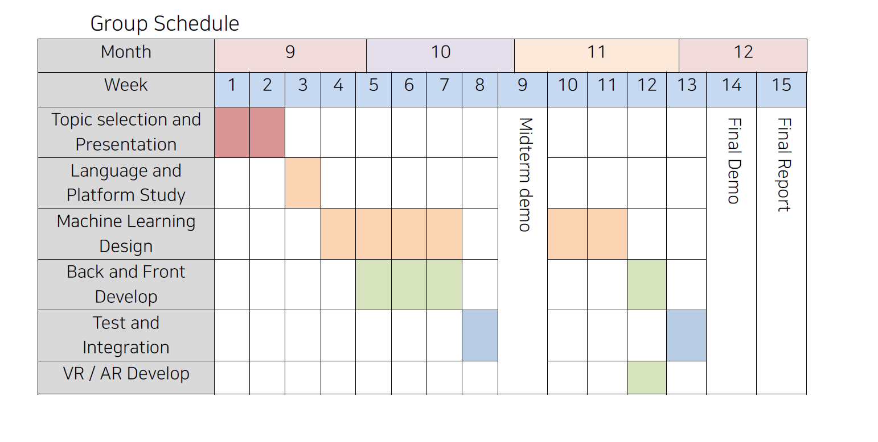
5. Project Schedule

Slide 14
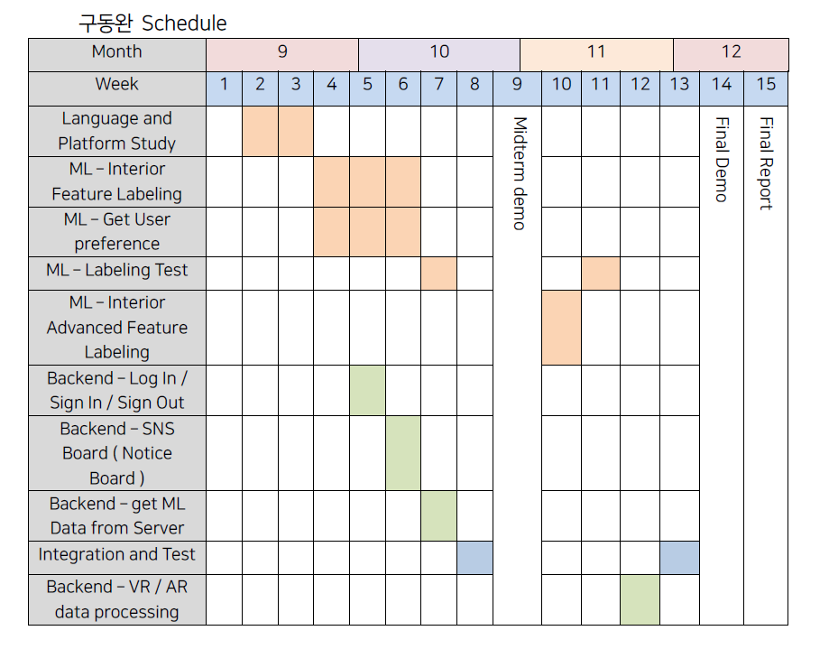
5. Project Schedule

Slide 15
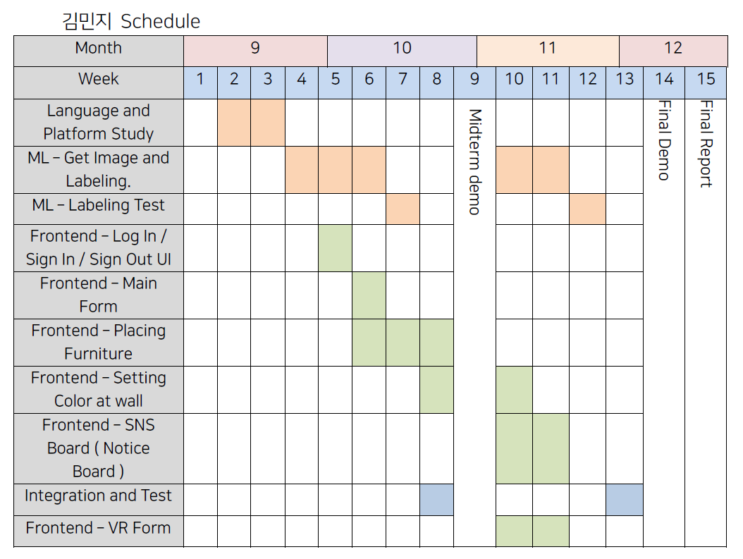
5. Project Schedule

Slide 16
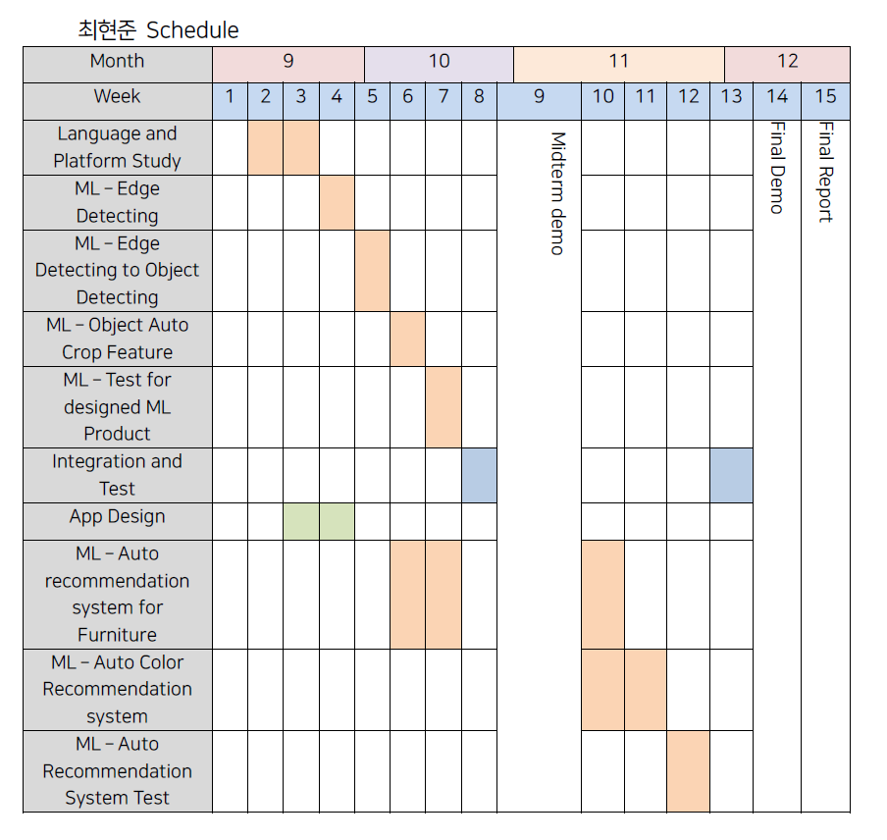
5. Project Schedule

Slide 17
Thank you
Capstone Design

